Slide 1



Internship Evaluation
Jan-Apr 2021
Aarati Medehal (PES1201700205) - ECE
Sneha N Baliga (PES1201701141) - ECE
V Saisri (PES1201701763) - ECE

Slide 2
TABLE OF CONTENTS
01
03
INTRODUCTION
SABKA BAZAAR APP
02
04
THE MEETINGS APP
THE AUDIT APP
Introduction
Demo
About the Company
Internship timeline
Tech Stack
Introduction
Demo
Introduction
Demo

Slide 3

ABOUT THE COMPANY
Publicis Sapient is an American digital consulting company, founded in Cambridge, Massachusetts in 1990 by Jerry Greenberg and J Stuart Moore..
Help unlock value through a startup mindset and modern methods, fusing strategy, consulting and customer experience with agile engineering and problem-solving creativity.
“Seize the Space between Next and Now.”

Slide 4
INTERNSHIP TIMELINE
Jan-Mar 2021
April 2021
May-June 2021
Training Period
Product Development Phase
Shadow Project
2
3
1
2
3

Slide 5






Tech Stack
VS Code
Lighthouse
Postman
NVDA
BITBUCKET
JIRA
Automated tool for improving the quality of web pages.
Collaboration platform for API development.
Redefined and modified code editor for building web applications.
GIT based source-code repository.
Bug tracking , issue tracking and project management.
Non-visual desktop access is a free,open source , portable screen reader.

Slide 6



Tech Stack
ES Lint
Sass
Storybook
Preprocessor scripting language compiled with CSS.
Environment for developing interactive component libraries for different frameworks.
Static code analysis tool to identify problems with your JS code.

Slide 7
01
THE MEETINGS APPLICATION

Slide 8
Introduction
Milestone 1
Milestone 2
Milestone 3
Milestone 4
The Meetings Application allows a user to manage your meetings.
Execution of the Meetings Application took place in 4 stages namely milestones.
Developing the basic static UI using HTML and CSS.
Incorporating JavaScript to make the webpage dynamic .
Fetch details from the provided backend.
Form validations and accessibility were taken care of.
ESLint,Unit Testing and bundling of scripts using webpack.
MVC architecture used to restructure the code .
ES2015 features used wherever applicable.

Slide 9
Key features
It has additional features such as:
Filter to view meetings (past,present or future).
Search for meetings based on meeting description.
Allows an user to Add a meeting and be part of it.
Lets you view your meetings in a calendar view.
Can create teams consisting of other users and view all teams you are a part of.
A user can also excuse themselves from a team

Slide 10
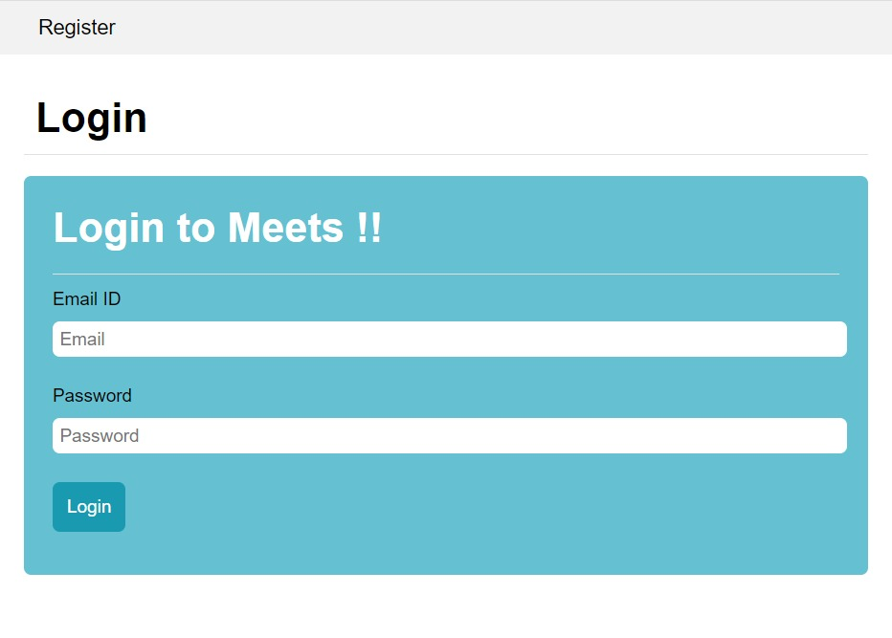
Page 1 - Register and Login
Once a new user registers on the app , he/she is directly redirected to the login page to enable them to login officially and start using the application.
Form validations - In Correct format , missing fields and empty form submission

Slide 11
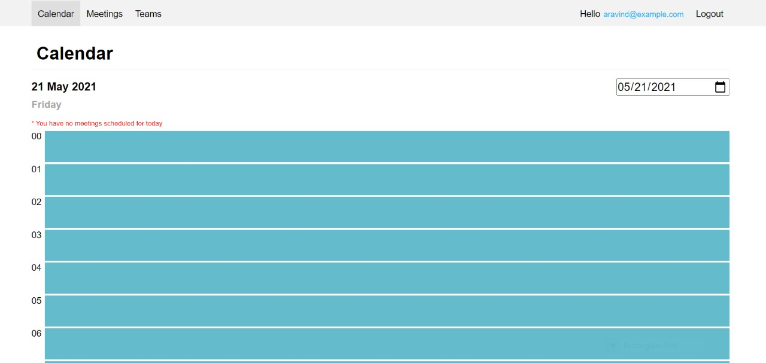
Page 2 - The Calendar Page
This shows the meetings for a day for the logged in user. By default the meetings for the current day are shown. The day can be selected using a date picker.

Slide 12
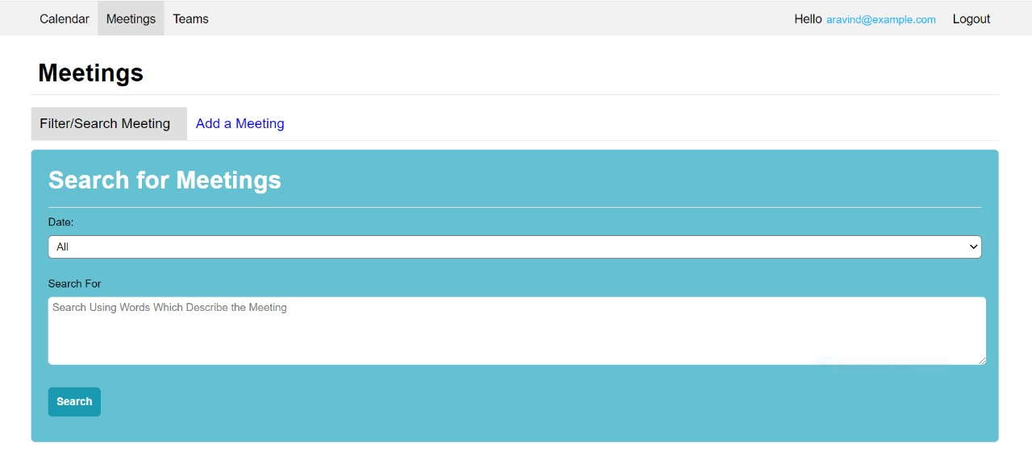
Page 3 - Filter and Search Meetings
The search / filter dropdown has options "ALL", "PAST", "TODAY", "UPCOMING". On selecting an option, the meetings are displayed in chronological order (earliest meeting first).
"ALL" is selected in this dropdown by default.

Slide 13
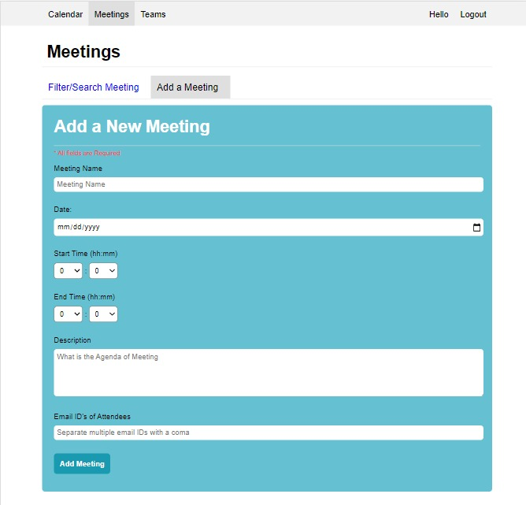
Page 4 - Add a Meeting Page
In this page , you can add a meeting (i.e. create a new meeting) . When doing so, the email id of participants, or team short name, can be given for attendees (separated by commas).
Form validations - Incomplete form submissions , End time greater than start time , email id’s of attendees.

Slide 14
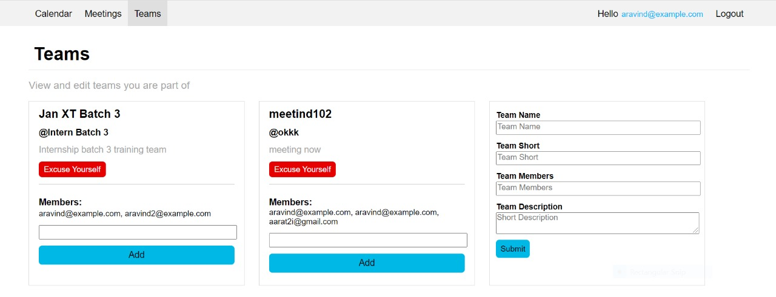
Page 5 - The Teams Page
You can view the details of teams you are part of, and add members to them. You can excuse yourself from the team (leave the team), but cannot remove anyone.
A team has a name, a short name (begins with @), a description, and a list of users (identified by their email ids). In order to add a user to a team, a dropdown with user names exists.

Slide 15


Slide 16
02
SABKA BAZAAR APP

Slide 17
INTRODUCTION
To help people to have easy access to their grocery shopping. The concept is to make grocery shopping for daily commodities more convenient for customers
Customers get the freedom to buy organic and hygienic fruits and vegetables at their doorsteps as it becomes time saving for customers.

Slide 18
KEY FEATURES
The development of the User Interface and some functionalities is currently our primary focus in this project.
We have used React.js to create the elements and setting up the react application was done using Create React App(CRA).
We have used Bootstrap for styles and Font Awesome for icons and to make Ajax requests we have used the popular axios library.

Slide 19
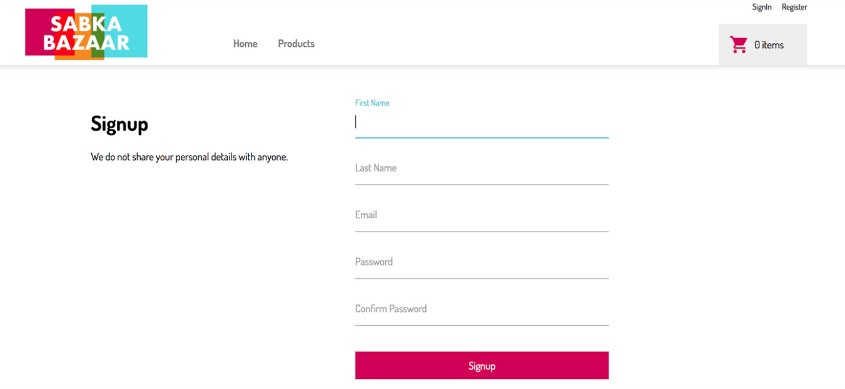
Page 1 - Register Page
If a user does not have an account, they can create one, and their information will be stored in the mock API.
When the user does not fill in any of the fields, the form is not submitted and focus moves to the first input which has an error.

Slide 20
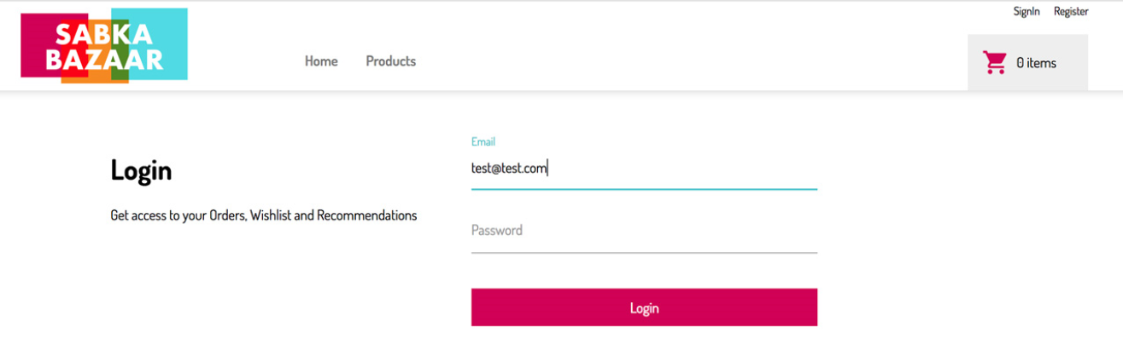
Page 2 - Login Page
A User can log into the App here if they already have one.
When the user does not fill in any of the fields, the form is not submitted and focus moves to the first input which has an error.

Slide 21
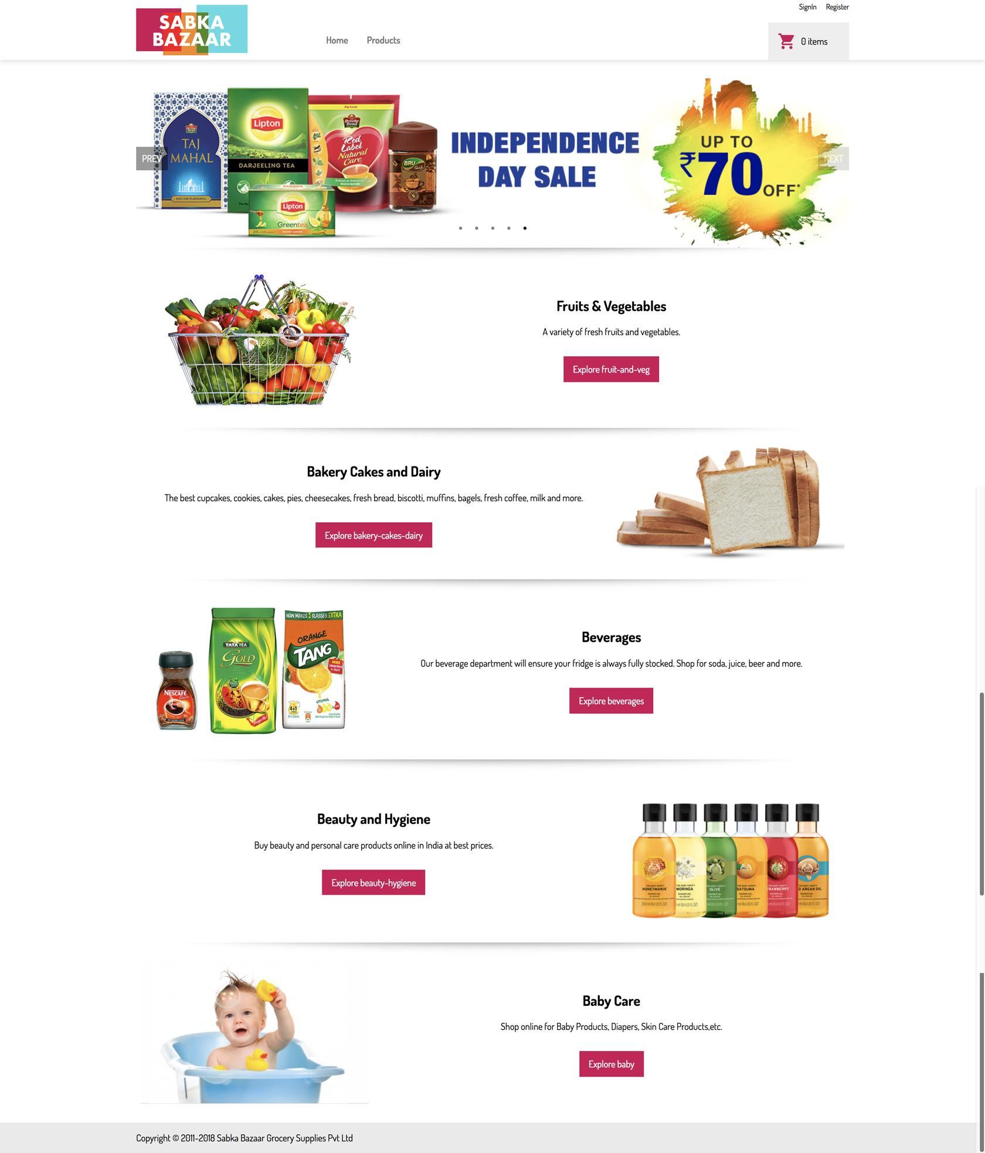
Page 3 - Home Page
This page lists all of the website's product categories.

Slide 22
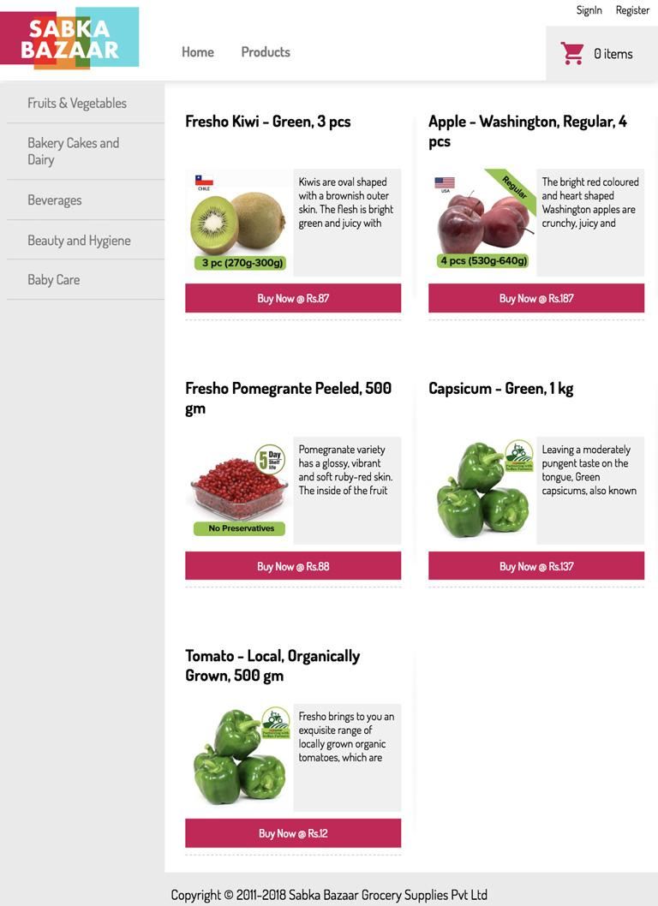
Page 4 - Products Page
This page will display the products of the selected category that are available to buy.
We can also filter the products by clicking on the required section

Slide 24
03
THE AUDIT APP

Slide 25
Introduction
Project audits are currently handled through an excel sheet which needs to be updated, circulated and maintained.
It is difficult to track the history, and a lot of back and forth happens.
The Audit App is a web application that will help to make this process streamlined, flexible and easy to use which keeps a record of the history as well.

Slide 26
Key Features
React Application
Atomic Design Pattern
Responsive
Accessible
Theming and Styled Components

Slide 27
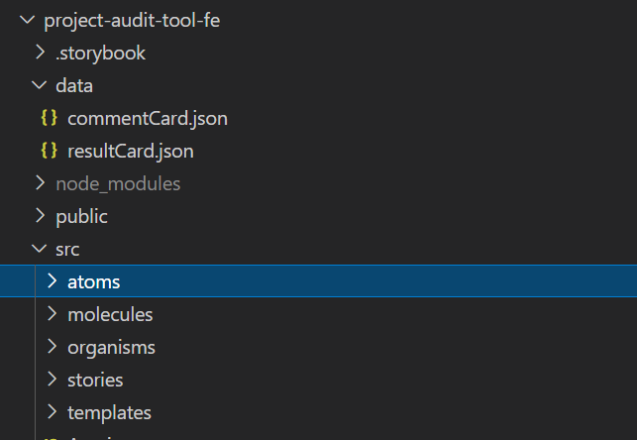
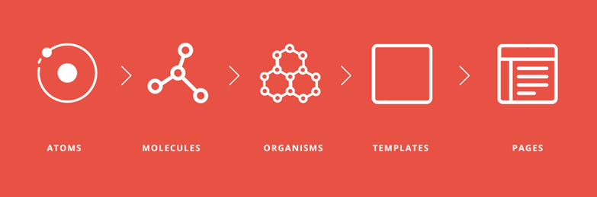
Atomic Design Pattern
Levels of Atomic Design
File Structure

Slide 28
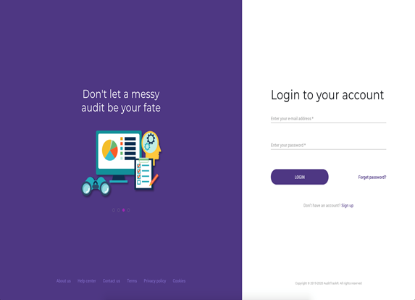
Page 1 - Login Page
Here, a User who already has an account can log into the App.
Form validations - If no field is entered, an error message arises.

Slide 29
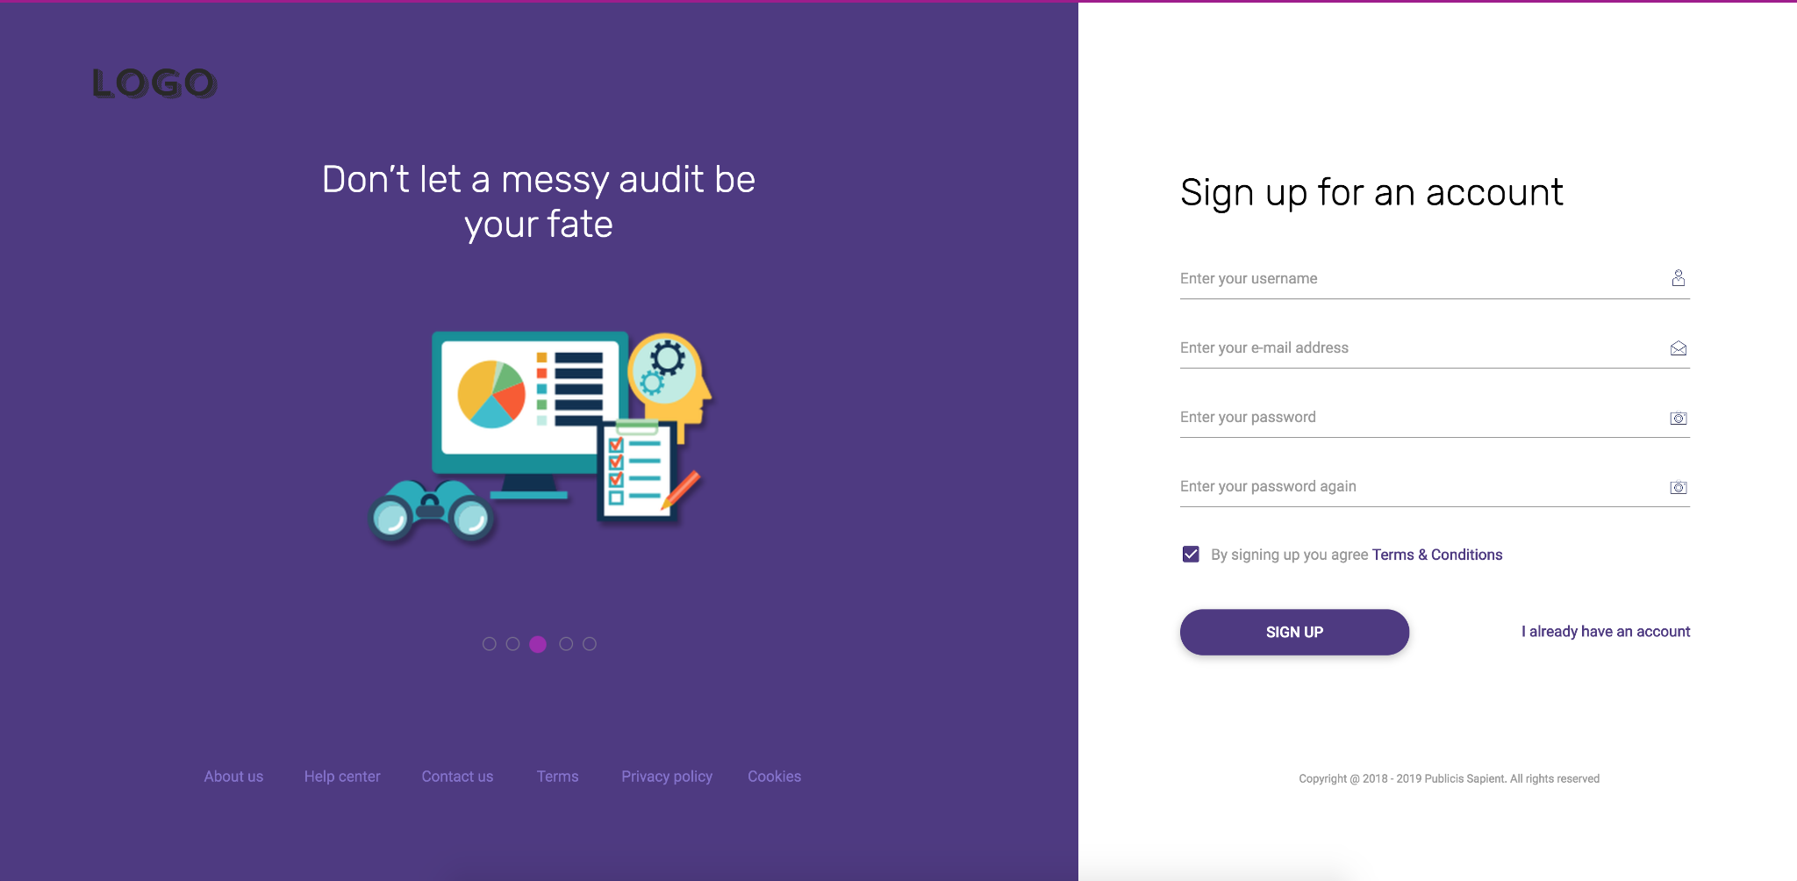
Page 2 - Sign Up Page
A User who does not have an account can Sign Up and their respective details get stored in the mock API.
Form validations - If no field is entered, an error message arises.

Slide 30
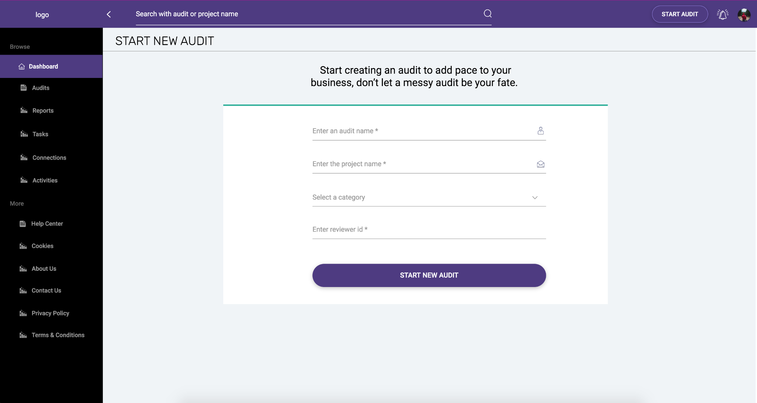
Page 3 - Start Audit Page
From this page, the User will fill the form in order to start a new audit. Various details of the new project must be filled in like-
A. Project Name
B. Category of the project
C. Reviewer must be filled in.

Slide 31
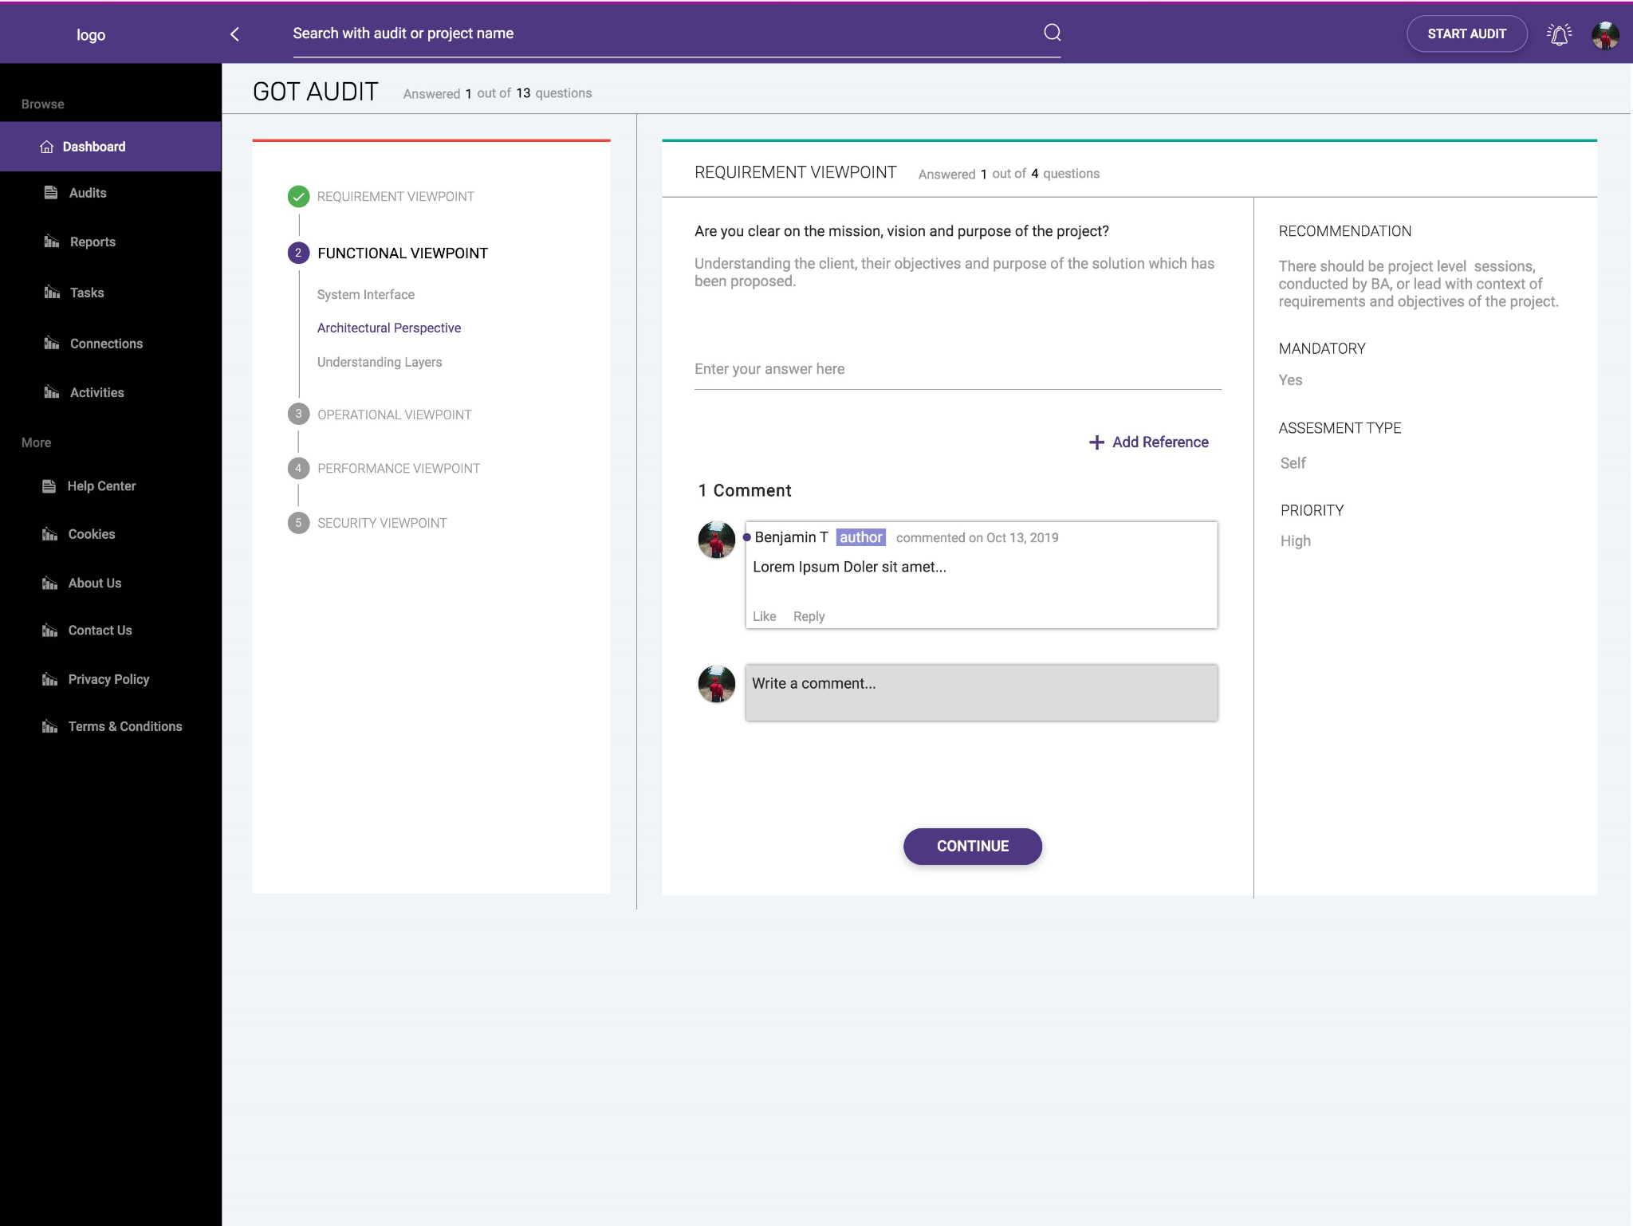
Page 4 - Questionnaires Page
The User can see the various requirements of the project.
The User can leave a comment.
User can check the history of the audit.
From this page, the User can share the particular audit with other reviewer/collaborator(s).

Slide 32
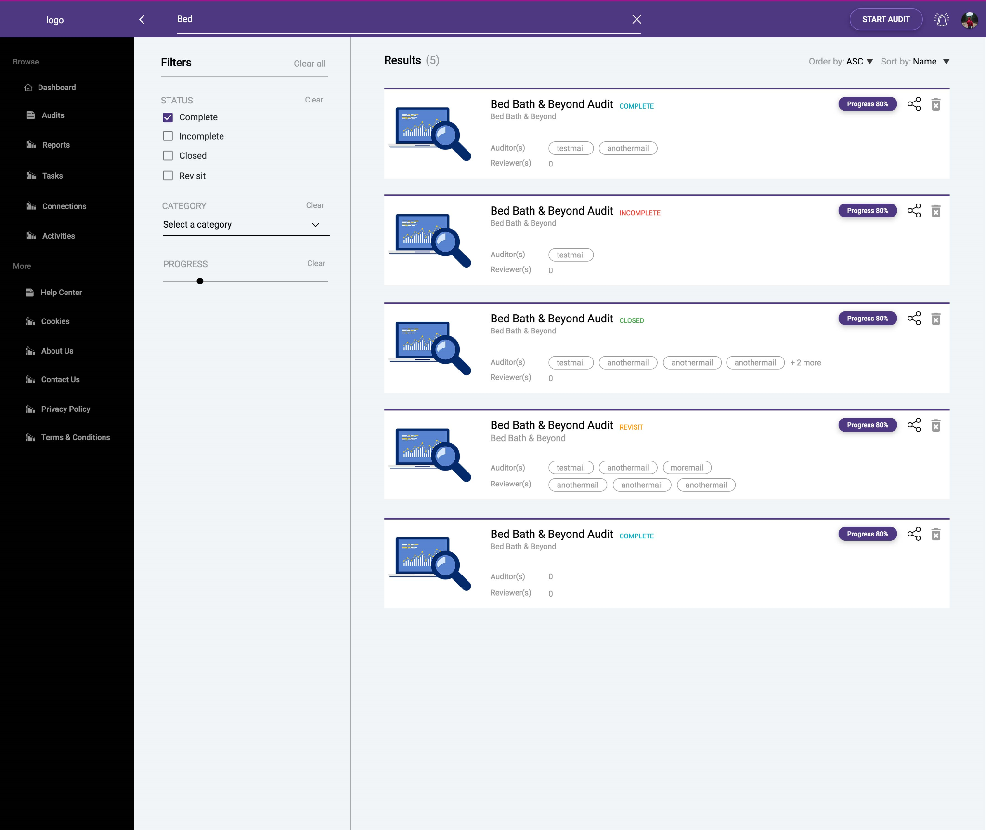
Page 5 - Search Landing Page
We can filter the Search results based on-
Status
Category and
Progress
We can further arrange the results in an ‘ascending’ or ‘descending’ order with respect to the Progress and Audit Name.

Slide 33
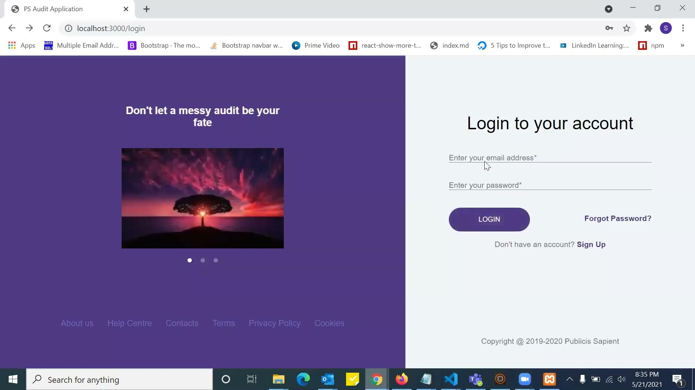

Slide 34
Thank You

